Slide 1
Generative AI

Slide 2
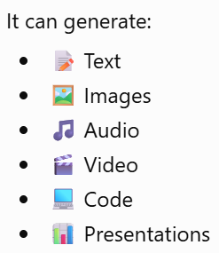
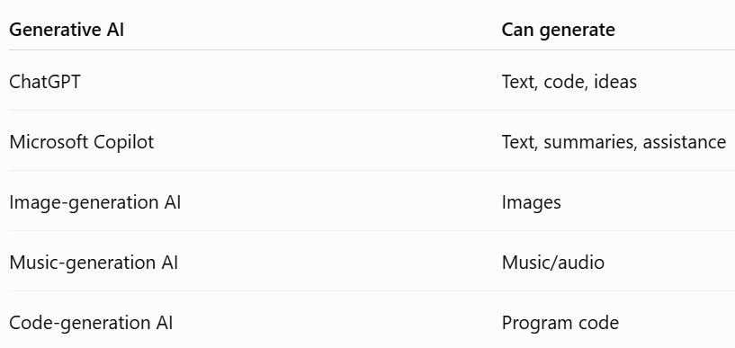
What is Generative AI?
Generative AI is a type of artificial intelligence that can create new content based on patterns learned from existing data.

Slide 3
What is Generative AI?

Slide 4
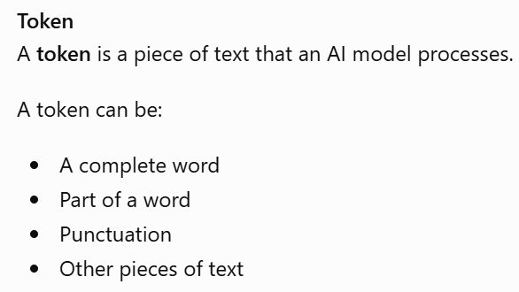
AI Linguistics
This section introduces concepts related to how AI systems process human language.

Slide 5
Prompt
A prompt is the instruction or input given to a generative AI system.
Examples:
Explain machine learning in simple terms.
Write a 100-word introduction about artificial intelligence
for second-year engineering students.

Slide 6
Prompt Engineering
Prompt engineering means designing effective prompts to obtain useful results from generative AI.
Weak prompt
"Tell me about AI."
This is very broad.
Better prompt
"Explain artificial intelligence to second-year engineering students in simple language. Give three real-world examples."
The second prompt provides:Topic + Audience + Difficulty level + Required output

Slide 7
Text-to-Image AI
Generative AI can create an image from a text description.

Slide 8
AI Companion in Content Creation
Generative AI can act as an AI companion to help humans create content.
Writing
Emails
Articles
Reports
Stories
Notes
Brainstorming
Ideas
Topics
Project ideas
Questions

Slide 9
AI Companion in Content Creation
Editing
Grammar correction
Rephrasing
Summarization
Changing tone
Coding
Generate code
Explain code
Debug code
Suggest improvements

Slide 10
New Opportunities with Generative AI
Generative AI can create new possibilities in:
Education
Personalized learning materials
Question generation
Summaries
Tutoring assistance
Lesson-plan generation
Creative industries
Image generation
Story creation
Music generation
Video generation

Slide 11
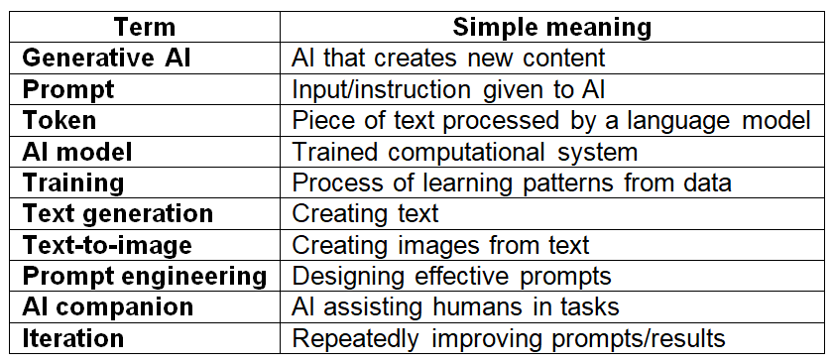
Important Generative AI Terms

